Slide 1
Machine learning
Chris geggis
2/2/2023

Slide 2
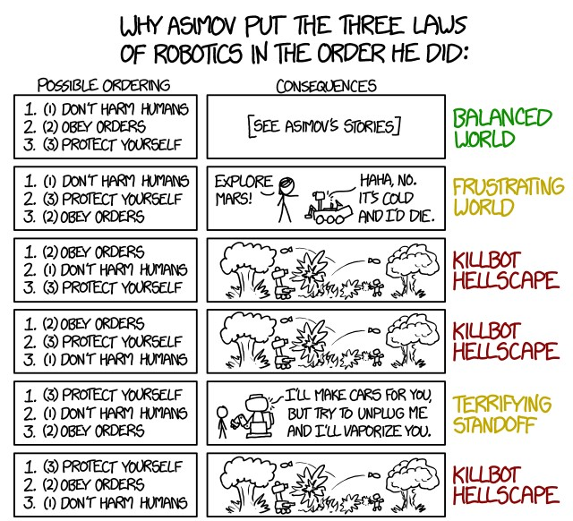
Attendance
The Actual Asimov 3 Laws:
A robot may not injure a human being or, through inaction, allow a human being to come to harm.
A robot must obey the orders given it by human beings except where such orders would conflict with the First Law.
A robot must protect its own existence as long as such protection does not conflict with the First or Second Laws.

Slide 3
Agents ~Five attributes
1. Operate autonomously
2. Perceive their environment
3. Persist over a prolonged time period
4. Adapt to change
5. Create and/or pursue goals

Slide 4
Agents – human perspective
Lawyers
Doctors
Accountants
Any Employee for any company, acting in a company capacity

Slide 5
Speaking of lawyers…
I am not a lawyer. This is not legal advice…talk to a lawyer for that.
All of the sudden, many recent lawsuits concerning AI are making there way through our judicial system
AI/ML (like ChatGPT) cannot copyright its creations, only humans can
Corporations are legally considered people, AI is not
Legal Eagle take on AI/ML legalities (20 min)

Slide 6
Agents interact with the environment
Perceptrons (or percepts) sense the environment
Sensors (light, electric, magnetic, sound, temperature, pressure, chemical, time)
Actuators act on the environment (robotic movement, software changes, sending network packets)
Percept sequence is the complete history of everything the agent has ever perceived
*An agent’s choice of action at any given instant can depend on its built-in knowledge and on the entire precept sequence observed to date, but not on anything it hasn’t perceived.

Slide 7
Agents – human perspective
We perceive light, and electricity (not much for magnetism, but yes for birds), sounds, smells (chemicals), touch, heat, body position
Our receptors send signals to our brains, and we may react.
Action or reactions might be movement, attention, talking, chewing, writing, typing, or some other interaction with the environment

Slide 8
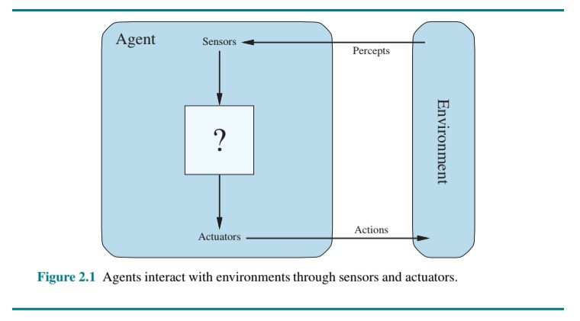

Slide 9
Good behavior: The concept of rationality
Rational Agent – does the “right” thing
Performance Measures:
Consequentialism – Evaluate (an agent’s) behavior by its consequences
Utilitarianism – Evaluate (an agent’s) behavior by its utility (usefulness)
> As a general rule, it is better to design performance measures according to what one actually wants to be achieved in the environment, rather than according to how the agent should behave

Slide 10
Rationality depends on four things
The performance measure that defines the criterion of success.
The agent’s prior knowledge of the environment.
The actions that the agent can perform.
The agent’s percept sequence to date.

Slide 11
Definition of a rational agent
For each possible percept sequence, a rational agent should select an action that is expected to maximize its performance measure, given the evidence provided by the percept sequence and whatever built-in knowledge the agent has.

Slide 12
Omniscience, learning, and autonomy
Omniscience is impossible in reality (Gödel Incompleteness Theorem)
Learning is done via “Information Gathering”
Information Gathering uses stored information (memory or “disk”) usually via a running program or a database
An agent that relies solely on the prior knowledge of its designer lacks autonomy
A rational agent should be autonomous and compensate for partial or incorrect prior knowledge

Slide 13
the task environment
Book gives the example of a taxi and vacuum (partially observable)
Fully observable – has the complete state of the environment, sensors to detect all aspects that are relevant to the choice of action. Generally simple situations.
Partially observable, in general, more common
Single-agent vs Multiagent – Agents view other entities as objects (single-agent) or another agent (multiagent) based on the maximizing performance measure
The environment may be competitive (chess) or cooperative (driving [hopefully])

Slide 14
The task environment
Deterministic – actions have known determined consequences
Nondeterministic – actions have unknown consequences (more common)
Stochastic deals in quantified probabilities, nondeterministic deals with unquantified probabilities
Episodic (agents experience can be broken in atomic episodes) vs Sequential (chess and taxi are sequential) agents early actions can affect all future decisions
Static environment vs Dynamic changing environment vs Semidynamic - performance score changes, but the environment does not

Slide 15
The task environment
Discrete (Chess, Poker, Backgammon) vs Continuous (Taxi Driving) - Refers to how time flows in the environment relative to the percepts and actions of the agent
Known vs Unknown refers to the agent’s knowledge of the “laws of physics,” not the environment itself
The hardest case is partially observable, multiagent, nondeterministic, sequential, dynamic, continuous, and unknown.

Slide 16
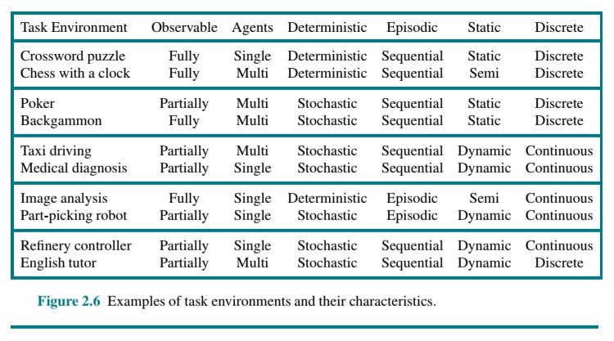

Slide 17
The structure of agents
Simple Reflex Agent – e.g. A vacuum that vacuums only when it perceives dirt, no percept history required
Condition-Action rule – If “condition” Then “perform action”

Slide 18
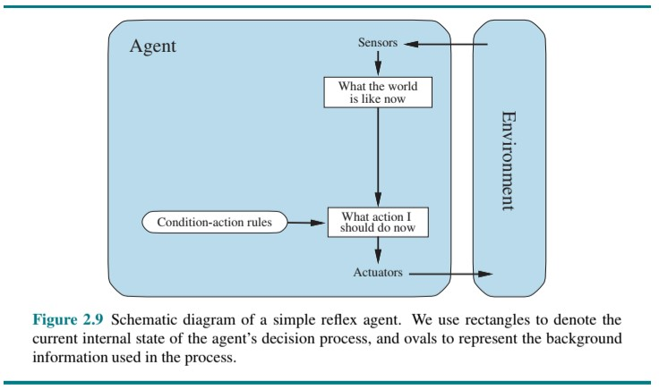

Slide 19
The structure of agents
Escape from infinite loops is possible if the agent can randomize its actions. For example, if the vacuum agent perceives [Clean], it might flip a coin to choose between Right and Left.
A well-designed agent should maintain an internal state which depends on the percept history and reflects some of what can no longer be observed. For example iRobot may maintain a map of the floor space in its memory
Transition Model – How the world works or what my actions do
Sensor Model – e.g. cameras or microphones

Slide 20
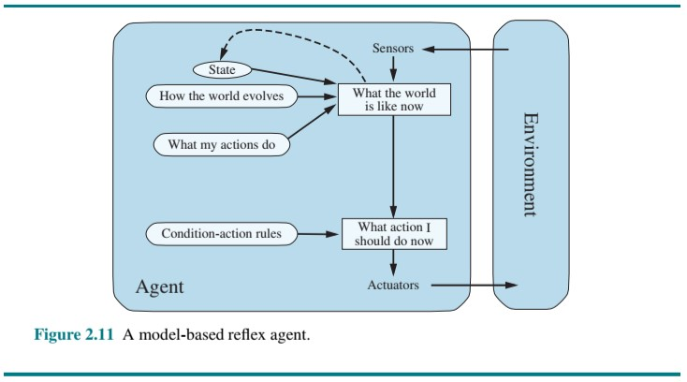

Slide 21
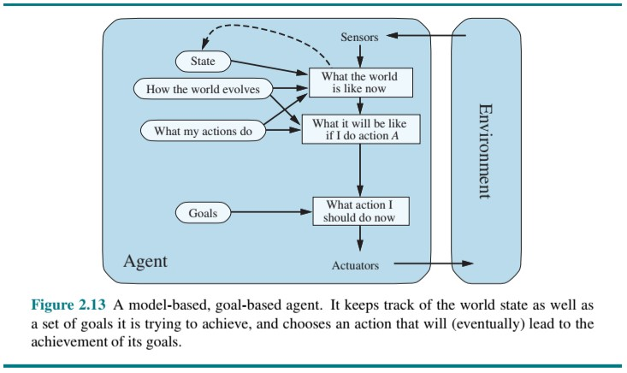

Slide 22
The structure of agents
Goals are not enough to generate high-quality behavior in most environments
Utility based agents – Will this make me happy?
An agent’s utility function is an internalization of the performance measure
A rational utility-based agent chooses the action that maximizes the expected utility of the action outcomes—that “expected utility” is, the utility the agent expects to derive, on average, given the probabilities and utilities of each outcome.
Expected utility does not always match real, actual utility

Slide 23
The structure of agents
Atomic – each state of the world is indivisible and there is no internal structure
Factored – splits states into a fixed set of variables or attributes each of which can have a value
Structured – The most complicated, and the most likely to represent real world scenarios
Localist vs Distributed. One to one mappings vs one to many mappings. Distributed is more common in real world scenarios

Slide 24
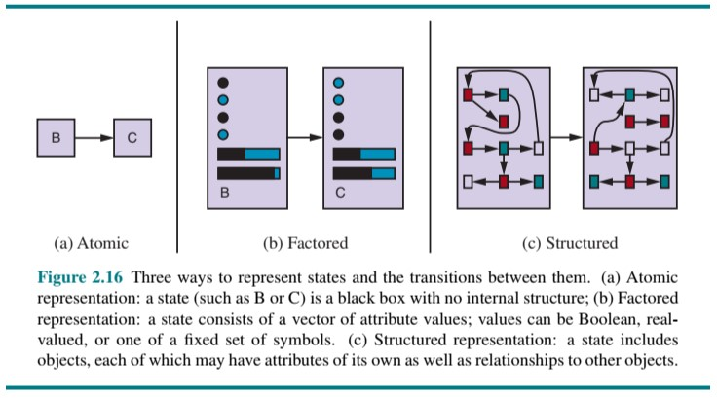

Slide 25
The structure of agents
The Learning Element is responsible for making improvements
The learning element uses feedback from Critic on how the agent is doing and determines how the performance element should be modified to do better in the future
The Performance Element is responsible for selecting external actions
The Problem Generator is responsible for suggesting actions that will lead to new and informative experiences
Rewards or penalties provide feedback on the quality of the agent’s behavior

Slide 26
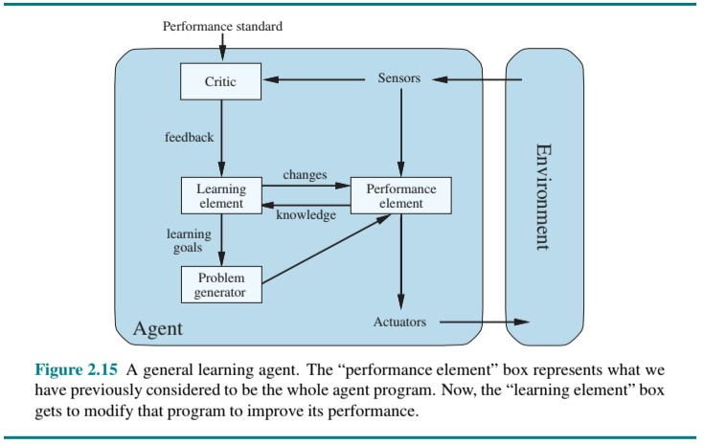

Slide 27
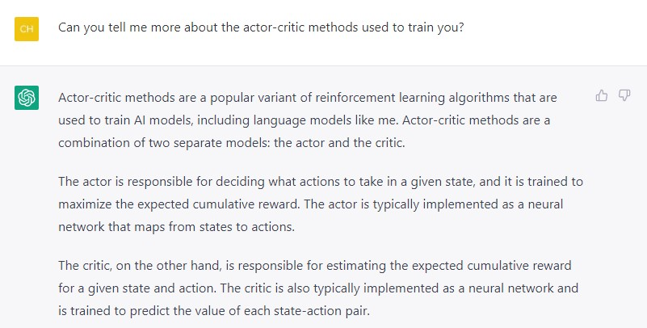
Chatgpt

Slide 28
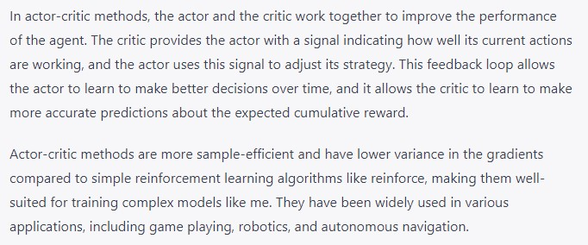
chatgpt

Slide 29
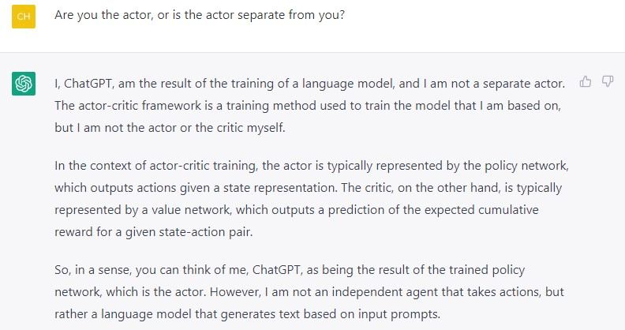
chatgpt

Slide 30
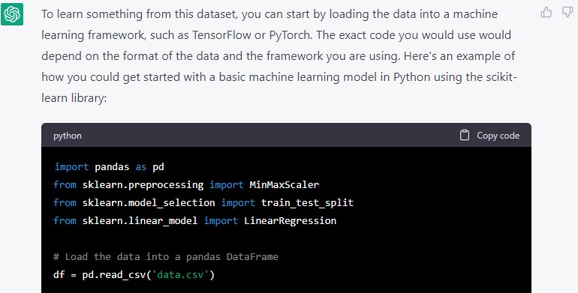
Chatgpt – final project

Slide 31
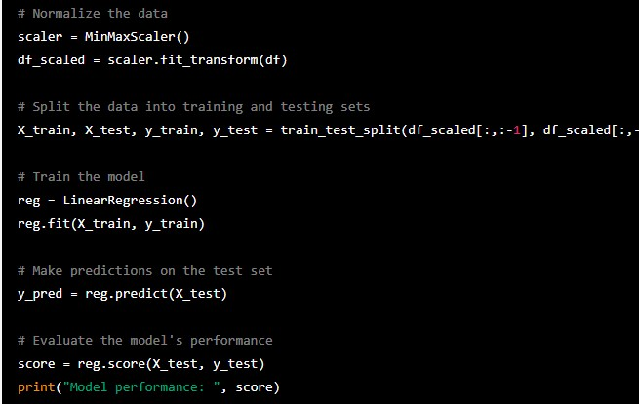
Chatgpt – final project

Slide 32
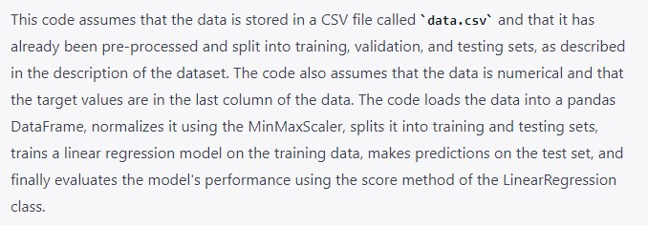
Chatgpt – final project

Slide 33
Game theory
Pruning - makes the search more efficient and ignores portions of the search tree that make no difference to the optimal move
Evaluation Function – estimates who is winning
Imperfect Information – e.g. card games, where the other players’ card are unknown

Slide 34
Search versus lookup
Table lookup is often used instead of search for the opening and endgame of Chess
Endgame tables are constructed using a retrograde minimax search. The player (or computer) finds all of the endgames and works in reverse.

Slide 35
Monte carlo search tree
AlphaGo – The Movie (2017) (Sponsored by Google)
https://www.youtube.com/watch?v=WXuK6gekU1Y&t=2823s&ab_channel=DeepMind
Policy Network (training data, table lookup), Value Network (evaluation function, weighted linear function, alpha-beta search, pruning), Tree Search (Monte Carlo Tree Search, pruning)

Slide 36
Monte Carlo Tree search
https://firecalc.com/
Simulations = Playout = rollout
A playout policy attempts to bias moves towards “good” moves
A pure Monte Carlo Search does N simulations starting from the current state of the game
A selection policy selective focuses the computational resources on the important parts of the game tree and balances exploration (what moves have not been looked at) and exploitation (what moves have done well in the past)

Slide 37
Monte carlo search tree
Alpha-Beta and Monte Carlo search can be combined (as shown in the movie)
An early playout termination may be employed if a playout is taking too many moves (i.e. a resignation or a draw)
Simulating moves in the future, observing the outcome, and using the outcome to determine which moves are good is a type of reinforcement learning. However, an opponents moves are not always predictable.

Slide 38
Stochastic games
Stochastic games bring us closer to the unpredictability of real life by including a random element, like dice or a “random” number generator
Chance nodes can be equated to a roll of the dice
Positions do not have definite values, but we can compute an expected value
This leads us to the expectiminimax value for games with chance nodes, a generalization of the minimax value for deterministic games
Backgammon is used as an example (7 highest probability dice roll)

Slide 39
Partially observable games
War games are often designed to be partially observable
Examples include StarCraft, Battleship, Stratego, Kriegspiel, Phantom Go, Phantom tic-tac-toe, and Screen Shogi
Kriegspiel plays like blind chess (rules are in the book)
A player must make a state estimation for their opponent
Strategy is altered for partially observable games

Slide 40
Card games
Card games such as bridge, whist, hearts, “local to Lowell” 45s, and poker feature stochastic partial observability, where the missing information is generated by the random dealing of cards.
Bluffing adds a another dimension to the game
Bridge is used as an example, 45s works too
Abstraction, is a strategy that treats similar hands as identical
Using abstraction the Libratus program beat top poker players in a 20-day match of Texas hold ’em no-limit (25M CPU hrs on a supercomputer, for the win)

Slide 41
Limitations of game search algorithms
Alpha-beta search is vulnerable to errors in the heuristic function
Alpha-beta and Monte Carlo sometimes waste computation time when the best move is obvious
Metareasoning is reasoning about reasoning
Alpha-beta and Monte Carlo do all of their reasoning at the level of individual moves, as opposed to using human goals and abilities to make quick abstract decisions

Slide 42
Ontological engineering
First Order Logic is the process we use to infer facts based on other facts
A fact is an abstract concept we have created in our minds
Other abstract concepts include, events, time, physical objects, and beliefs
Representing these abstract concepts is sometimes called ontological engineering
The general framework of concepts is called upper ontology

Slide 43
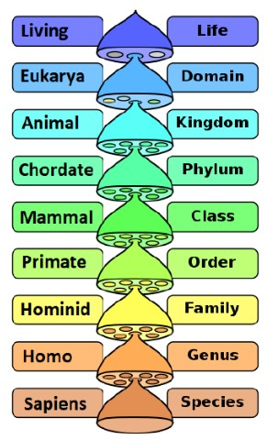
Ontological engineering
We use categories to organize objects
Living organisms consist of domains,
which consist of kingdoms,
which consist of phyla,
which consist of classes,
which consist of orders,
which consist of families,
which consist of genera,
which consist of species
Subcategory = subclass = subset

Slide 44
Categories and objects
There are two choices for representing categories in first-order logic: predicates and objects. That is, we can use the predicate Basketball(b), or we can reify the category as an object, Basketballs.
Categories organize knowledge through inheritance
Subcategories inherit properties from the superclass or parent class
Subclass relationships organize categories into a taxonomic hierarchy or taxonomy
When asked what one could deduce about the Creator from the study of nature, biologist J. B. S. Haldane said “An inordinate fondness for beetles.” (Footnote)
About one quarter of all known animals are beetles (~400K species of beetles, ~1.5M species of animals)

Slide 45
Categories and objects
Two or more categories are disjoint if they have no members in common (e.g. undergraduate students and graduate students)
Undergraduate students and graduate students form an exhaustive decomposition of university students
A[n] exhaustive decomposition of disjoint sets is known as a partition

Slide 46
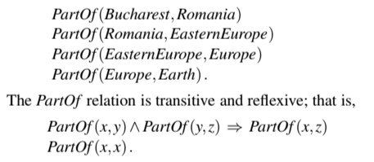
Physical composition
Glossary of mathematical symbols - Wikipedia

Slide 47
Physical composition
Categories of composite objects are often characterized by structural relations among parts. For example, a biped is an object with exactly two legs attached to a body.
We are currently talking about physical objects. When we discuss physical objects we can easily explore concepts or representations such as a bunch of objects, like apples. It is more difficult to discuss a bunch of virtual objects that don’t really exist, but it is possible

Slide 48
measurements
In both scientific and commonsense theories of the world, objects have height, mass, cost, and so on. The values that we assign for these properties are called measures.
Measurements have a units function which takes a number as an argument. For example, the distance from the start of the race to the end is 6 km. km is the units function, 6 is the number argument.
Qualitative physics is a subfield of AI that investigates how to reason about physical systems without plunging into detailed equations and numerical simulations.

Slide 49
Insert: Natural kind categories
Most categories in the real world have no clear-cut definition. We call these natural kind categories.

Slide 50
Objects: Things and stuff
Individuation is the way we divide things into distinct objects
Example: One aardvark and some butter (let’s say a tub of it)
(Arguably) Some butter cannot be divided into some number of “butter-objects”
We give this portion the generic name stuff
Now we can make a distinction between things (aardvarks) and stuff (butter)
Things like aardvarks, basketballs, or tomatoes are count nouns
Stuff like butter, water, or energy are mass nouns
When cut in half, stuff retains its intrinsic properties
Extrinsic properties (weight, length, shape) are lost upon subdivision

Slide 51
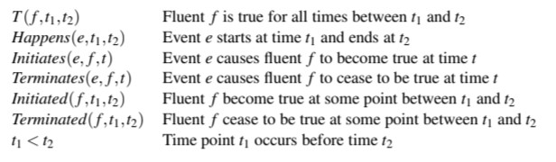
Events and time
Event calculus allows us to add time to our ontology
Event calculus opens us up to the possibility of talking about time points and time intervals
Event viewer – Windows, Console – Mac, /var/log/[syslog] – Linux

Slide 52
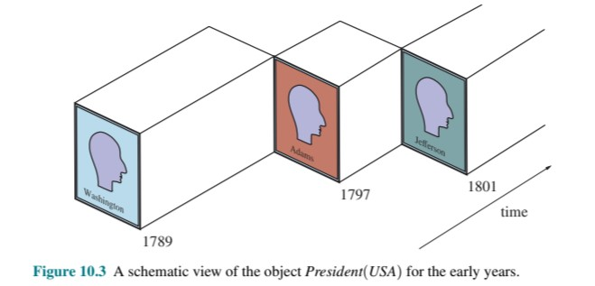
Fluents and objects

Slide 53
Mental objects and modal logic
How should we model and manipulate mental objects?
Set Theory
∈
Denotes set membership, and is read "in" or "belongs to". That is, means that x is an element of the set S.
⊂
Denotes set inclusion. However, two slightly different definitions are common.
1. A ⊂ B may mean that A is a subset of B, and is possibly equal to B; that is, every element of A belongs to B; in formula, ∀x, x ∈ A ⇒ x ∈ B.
2. A ⊂ B may mean that A is a proper subset of B, that is the two sets are different, and every element of A belongs to B; in formula, A ≠ B ∧ ∀x, x ∈ A ⇒ x ∈ B.

Slide 54
Mental objects and modal logic
⊆
A ⊆ B means that A “is a subset” of B. Used for emphasizing that equality is possible, or when the second definition of A ⊂ B is used.
∃
1. Denotes existential quantification and is read "there exists ... such that". If E is a logical predicate, ∃xE means that there exists at least one value of x for which E is true.
2. Often used improperly^{[3]} in plain text as an abbreviation of "there exists".

Slide 55
Mental objects and modal logic
Basic Logic
∧
1. Denotes the logical and, and is read as "and". If E and F are logical predicates, E ∧ F is true if E and F are both true. It is often replaced by the word "and" or the symbol "&".
2. In lattice theory, denotes the meet or greatest lower bound operation.
3. In multilinear algebra, geometry, and multivariable calculus, denotes the wedge product or the exterior product.
∨
1. Denotes the logical or, and is read as "or". If E and F are logical predicates, E ∨ F is true if either E, F, or both are true. It is often replaced by the word "or".
2. In lattice theory, denotes the join or least upper bound operation.
3. In topology, denotes the wedge sum of two pointed spaces.

Slide 56
Mental objects and modal logic
∀
1.Denotes universal quantification and is read as "for all". If E is a logical predicate,
∀x E means that E is true for all possible values of the variable x.
2. Often used improperly^{[3]} in plain text as an abbreviation of "for all" or "for every".
⇒
1. Denotes material conditional, and is read as "implies". If P and Q are logical predicates, means that if P is true, then Q is also true.
Thus, is logically equivalent with Q ∨ ¬ P.
2. Often used improperly^{[3]} in plain text as an abbreviation of "implies".

Slide 57
Mental objects and modal logic
⇔
1. Denotes logical equivalence, and is read "is equivalent to" or "if and only if".
If P and Q are logical predicates, P ⇔ Q is thus an abbreviation of (P ⇒ Q) ∧ (Q ⇒ P), or of (P ∧ Q)
2. Often used improperly^{[3]} in plain text as an abbreviation of "if and only if".
¬
Denotes logical negation, and is read as "not". If E is a logical predicate, ¬E is the predicate that evaluates to true if and only if E evaluates to false. For clarity, it is often replaced by the word "not". In programming languages and some mathematical texts, it is sometimes replaced by "~" or "!", which are easier to type on some keyboards.

Slide 58
Mental objects and modal logic
⊨
In logic, the symbol ⊨, ⊧ is called the double turnstile. It is often read as "entails", "models", "is a semantic consequence of" or "is stronger than".^{[1]} It is closely related to the turnstile symbol, which has a single bar across the middle, and which denotes syntactic consequence (in contrast to semantic). Logical consequence or Semantic consequence

Slide 59
Mental objects and modal logic
Propositional attitudes are attitudes that agents have towards mental objects. E.g. believes, knows, wants, informs
Modal Logic adds special modal operators that take sentences as arguments
“A knows P” can be written as K_{A}P
One problem with modal logic is that it assumes logical omniscience. Meaning there is an assumption that if an agent knows a set of axioms, then it knows all consequences of those axioms.

Slide 60
Reasoning systems for categories
Semantic networks provide graphical aids for visualizing a knowledge base and efficient algorithms for inferring properties of an object on the basis of its category membership
In some circles UML = Unified Modeling Language, and not UMass Lowell
https://en.wikipedia.org/wiki/Unified_Modeling_Language
Description logics provide a formal language for constructing and combining category definitions and efficient algorithms for deciding subset and superset relationships between categories.
Pseudocode vs Code

Slide 61
Semantic graphs
Existential graphs, were proposed by Charles Peirce (in 1909)
Graphs and modeling language are good at representing inheritance
Multiple inheritance is banned in some object-oriented programming (OOP) languages (Java)
A procedural attachment is utilized when a specific relation results in a call to a special procedure, like an exception (e.g. a catch in a try{} catch{})
Semantic networks usually have default values for categories.
Sometimes default values are overridden

Slide 62
Description logics
The syntax of first-order logic is designed to make it easy to say things about objects
Description logics are notations that are designed to make it easier to describe definitions and properties of categories
The principal inference tasks for description logics are subsumption (checking if one category is a subset of another by comparing their definitions) and classification (checking whether an object belongs to a category).
Some systems also include consistency of a category definition-whether the membership criteria are logically satisfiable

Slide 63
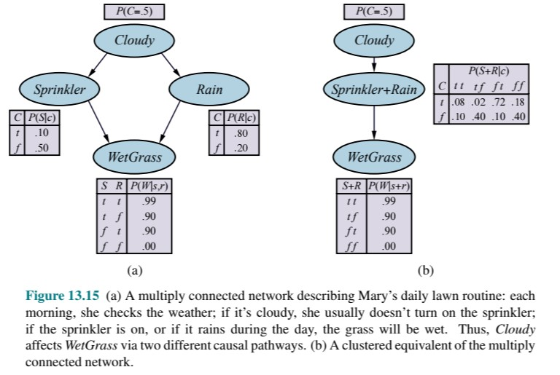
clustering
Clustering = join tree, creates meganodes

Slide 64
Hollywood ending CS Movie (pick of the week)
Her (2013)
In a near future, a lonely writer develops an unlikely relationship with an operating system designed to meet his every need.

